Slide 1
CSE 3412
Software Development Methodologies
Sidratul Muntaha
LECTURER, DEPT. OF CSE, UIU
ACKNOWLEDGED: SAMIN SHARAF SOMIK

Slide 2
What is Software Development Methodologies?

Slide 3
A structured management of the workflow during a project

Slide 4
Ways of Implementing Software Development Life-Cycle (SDLC)

Slide 5
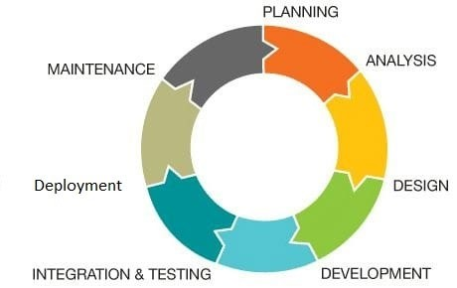

Slide 6
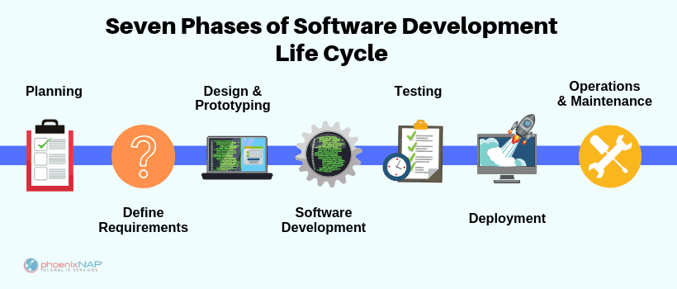

Slide 7
Planning
Defining Scope
Feasibility Analysis
Benchmark Study

Slide 8
Requirement Analysis
Analyzing the Resources:
Hardware
Software
Skilled People
Time

Slide 9
Designing & Prototyping
Visual Representation of the project :
- Wireframe Modeling
Prototype: A prototype is an early sample, model, or release of a product
- Manual/ Digital Prototyping

Slide 10

Development/ Implementation

Slide 11

Testing

Slide 12

Deployment/ Release

Slide 13
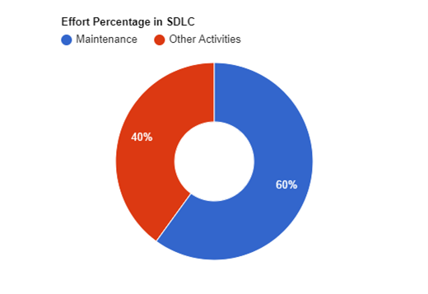
Maintenance

Slide 14
Maintenance
Post-release bug fixing
Check for optimization & improvement scope
Deletion of outdated features/ data
Enhancement of existing features
Migration
Release newer versions

Slide 15
Thank You

